Slide 1
Benford's Law Analysis
What is Benford's Law?
P(d) = Log10(1+1/d)
How is it used in forensic accounting?
How does Walmart’s data follow Benford’s Law?

Slide 2
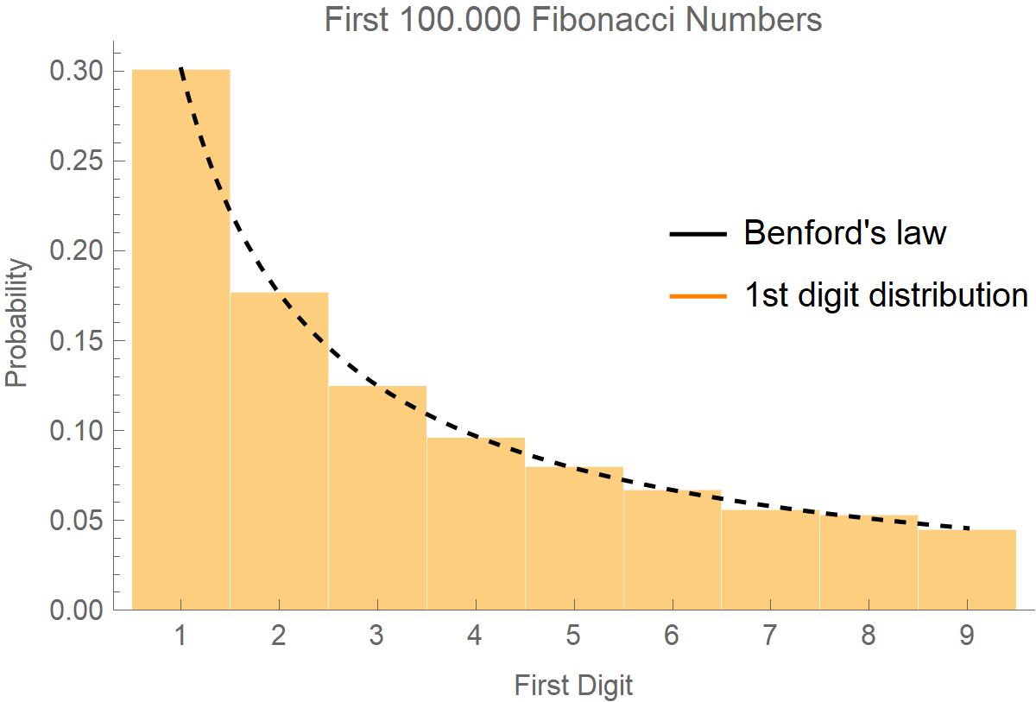
What is Benford’s Law?
If the distribution of digits in a data set were even, then the proportion of each digit would be roughly 11.1%.
The real proportion can be found by this equation:

Slide 3

How has Benford’s Law been used?
Bernie Madoff was a chairman at the Nasdaq stock exchange.
Between the years of 1990 and 2008, Madoff fabricated thousands of balance sheets over reporting returns on investments.

Slide 4
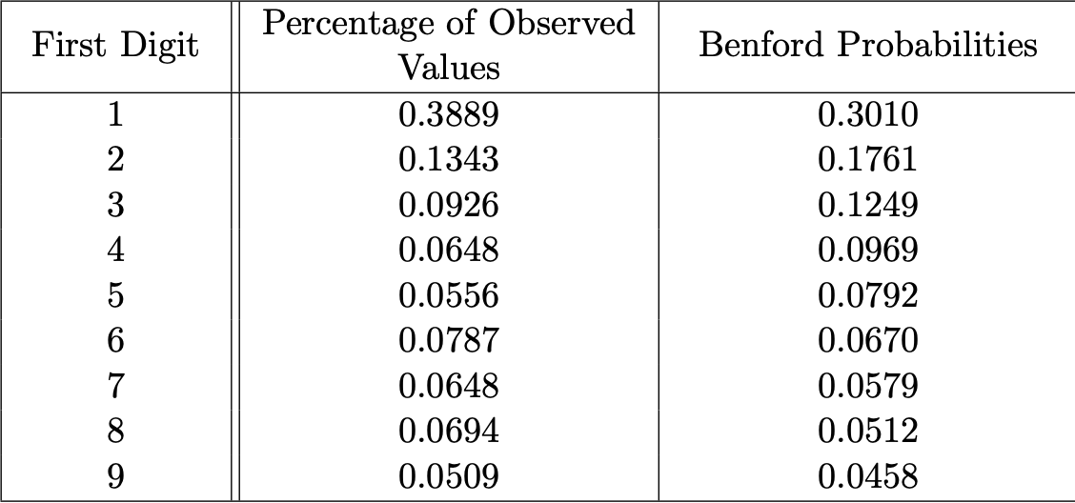
Madoff’s Balance Sheet:
These numbers were calculated by Juan Chang in 2017 as a part of his dissertation about Benford’s law.

Slide 5
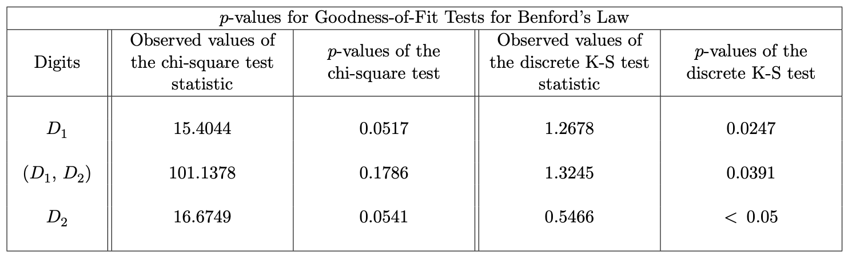
Kolmogorov-Smirnov test vs Chi Square test
Kolmogorov- Smirnov test (or KS test) and Chi Square test are both tests for goodness of fit.
KS test quantifies the cumulative distance between a numeric vector and its predicted equation.
Chi Square test examines the difference between 2 categorical variables.

Slide 6
Does Walmart’s Data Match Benford’s Law?
Read our Walmart data from 2009 to 2019 into R studio into a numeric vector. Then the package Benford.analysis was used. The following statistics were calculated:
First Digit:
X-squared = 140.09, df = 8, p-value < 2.2e-16
Mean Absolute Deviation (MAD): 0.03512796 MAD Conformity - Nigrini (2012): Nonconformity Distortion Factor: 9.88323
Second Digit:
X-squared = 296.78, df = 89, p-value < 2.2e-16
Mean Absolute Deviation (MAD): 0.00456162
MAD Conformity - Nigrini (2012): Nonconformity
Distortion Factor: 9.88323
Notes:
Read our Walmart data from 2009 to 2019 into R studio into a numeric vector. Benford’s Law analysis does not care what the numbers mean, just that they match the given proportion.
The package Benford.analysis was used to calculate initial Chi Square test. Due to the inaccuracies of the P value for Chi Square when performing Benford’s Law’ analysis, R calculates a Mean Absolute Deviation of .035, meaning generally nonconformity to Benford’s law.

Slide 7
Kolmogorov-Smirnov Test
Using the BenfordTests package in R, the data was fed into the following function:
ks.benftest(x = V, digits = 1, pvalmethod = "simulate", pvalsims = 10000)
Then the following D-Statistic and P-Value were calculated for the first 2 digits:
D = 23.001, p-value < 2.2e-16
Using a significance level of 1% with an alpha of .01. With our calculated P value of 2.2e-16, we reject H0. There is significant statistical evidence that Walmart’s data does not conform to Benford’s law with a significance level 0f 99%.

Slide 8
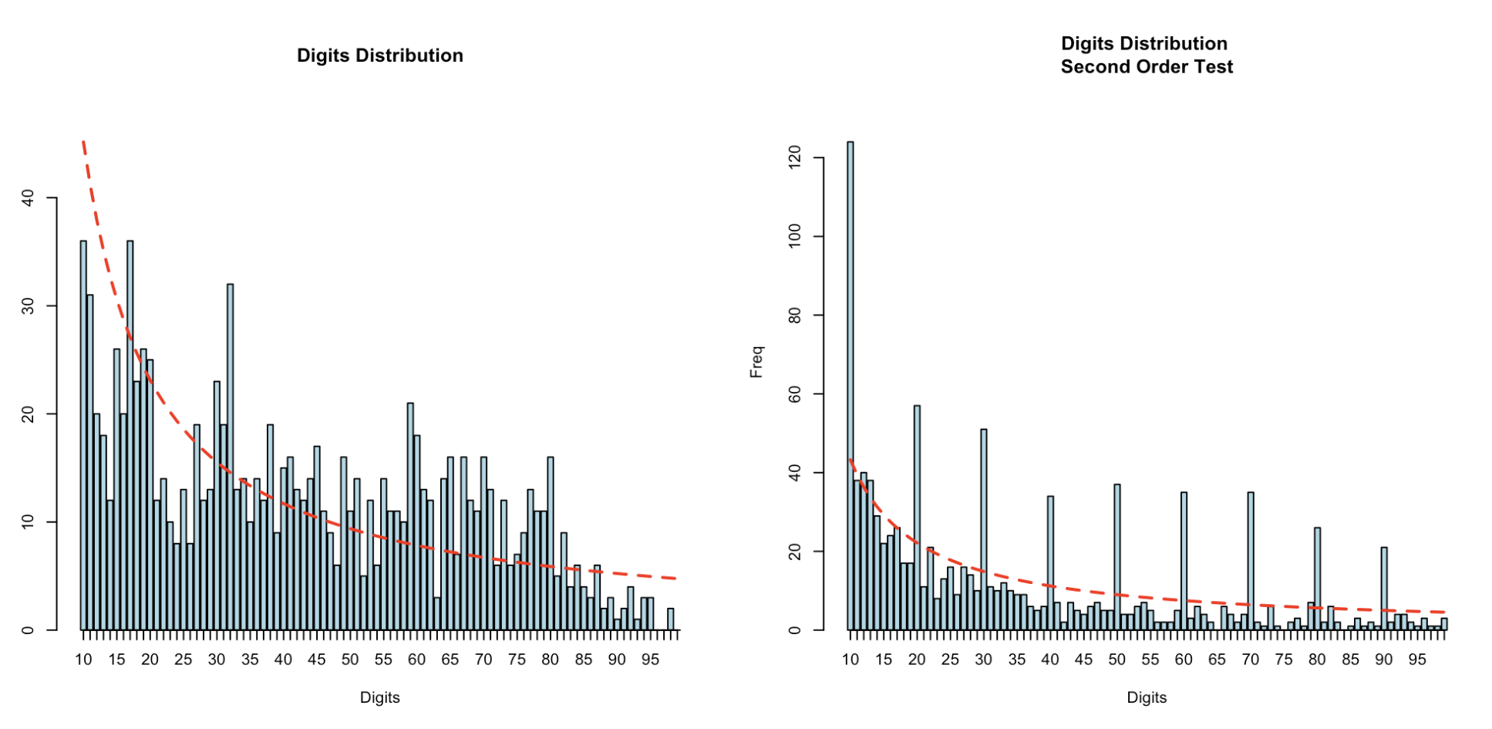
What does this look like?
These Graphs were made from the Benford.Analysis package for the first 2 digits of Walmart's data.

